Slide 1
A Community of
First Responders
Because this can’t wait

Slide 2

Overdoses by the Numbers in America
  One hundred and thirty people die from opioid overdoses daily.
  Naloxone can help if there when needed – but the window is small.
  The National Fire Protection Association’s (NFPA) standard for response time is four minutes ninety percent of the time.
  Brain damage is likely to occur for a victim after four to six minutes without oxygen; death is likely after ten minutes.
  A recent review of EMS records from 485 agencies across the United States showed average response times of seven-minutes in urban settings compared to 14 minutes in rural settings

Slide 3
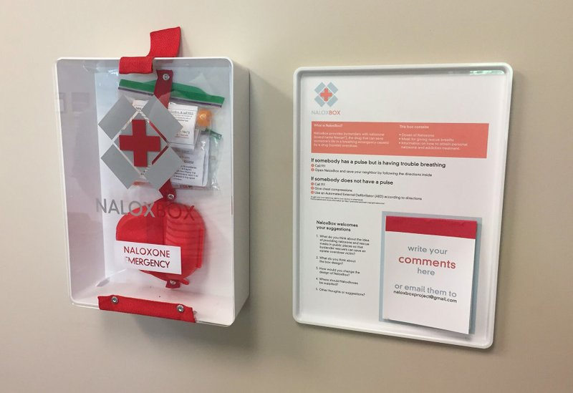
NaloxBox
Dr. Geoffrey Capraro Rhode Island Ep. # 112
Inspired by the proliferation of AEDs for heart attacks
Kit contains Naloxone and tools like breath masks
Ambulance wait-times, even 8 minutes, too late
Gives a second chance for recovery
Aids bystander rescuers
NaloxBox.Org
AntiOD

Slide 4
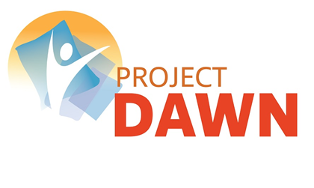
Project DAWN (Deaths Avoided with Naloxone)
Emily Metz Cleveland, Ohio Ep. # 10
Program Launch 2013
Provide Naloxone Training and DAWN Kits
6,430 Kits Provided
Known Project DAWN Lives Saved to Date: 982

Slide 5
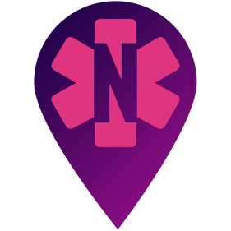


NaloxoFind
Matthew Shaker Virginia Ep. # 233
  NaloxoFind a free app allowing anyone to locate all registered naloxone carriers within a 2 mile radius in an emergency.
  First responders (e.g., off-duty police) carry naloxone and register.
  Citizens who otherwise carry naloxone can register with the app.
  Health care providers (e.g., physicians and pharmacists) and trainers inform patients of when prescribing/dispensing naloxone.
  Community outreach.

Slide 6
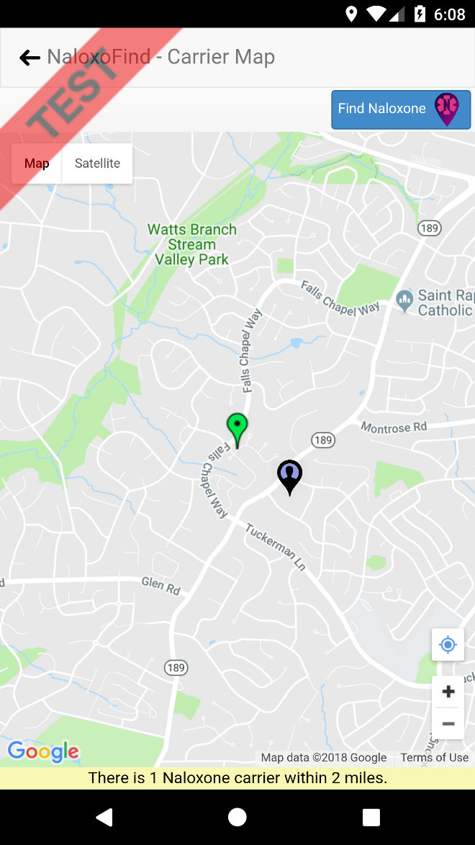
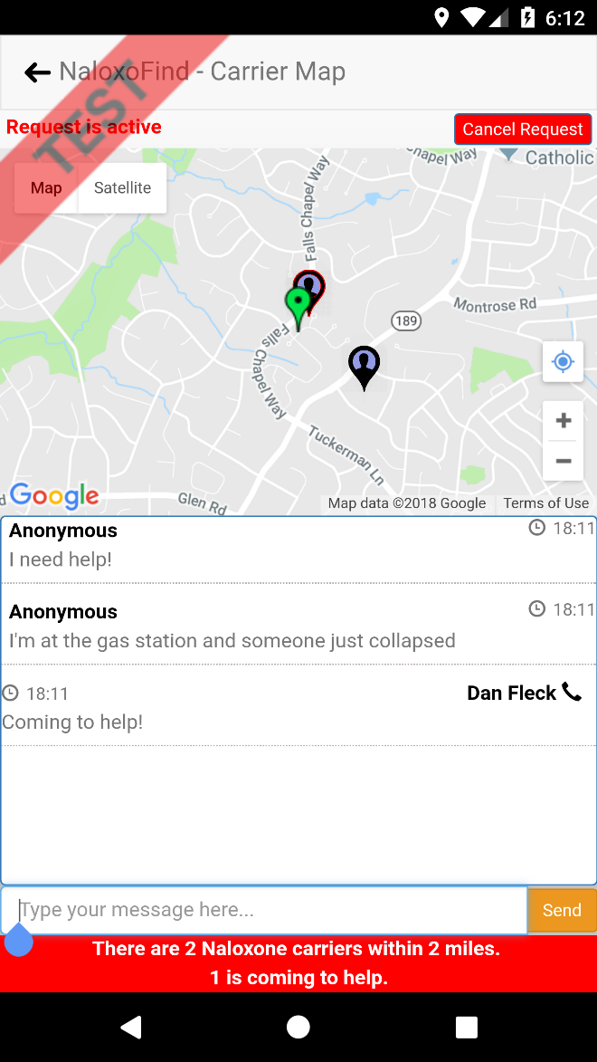
NaloxoFind
Matthew Shaker Virginia Ep. # 233
  NaloxoFind a free app officially launched in May 2018.
  Available on Apple App Store and Google Play.
  Self-funded to date by Altrix Medical.

Slide 7
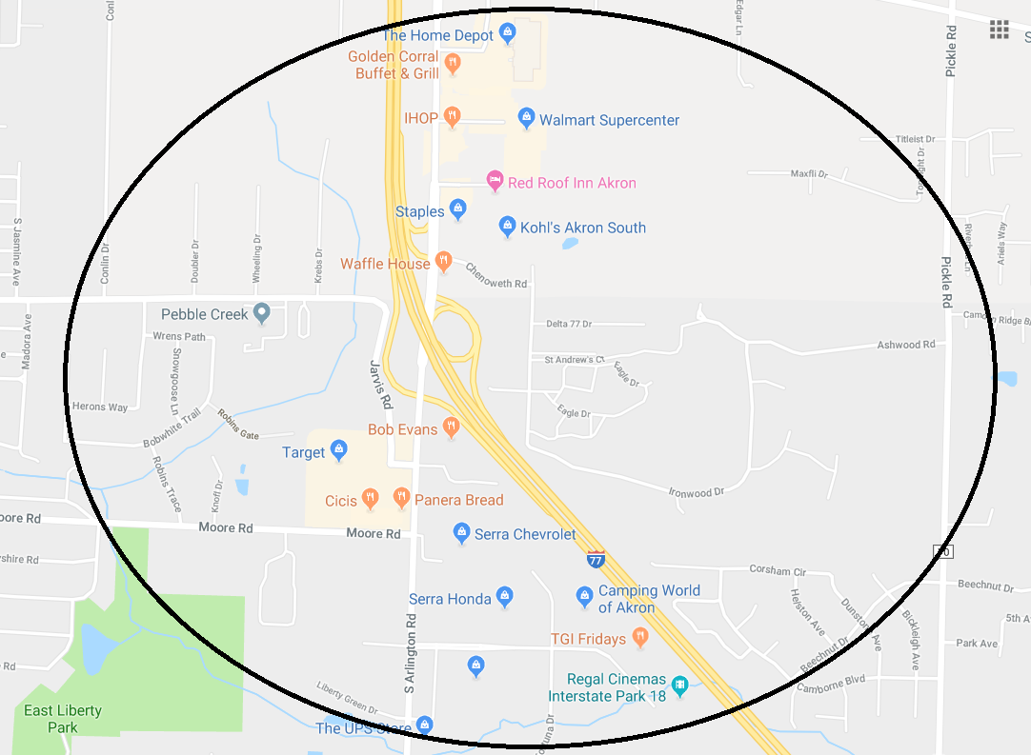
Community of First Responders
Pilot Project: 44232 City of Green , Ohio

Slide 8
Community of First Responders
Pilot Project: 44232 City of Green, Ohio
Map and Finalize NaloxBox Locations
Recruit Community of First Responders from Neighborhood Stakeholders
Conduct Project DAWN Training
Download NaloxoFind and Register Community of First Responders
Coordinate Community ODMAP Reporting

Slide 9



A Community of
First Responders
Because this can’t wait

